Slide 1
EEE1024:
Fundamentals of Electrical and Electronics Engineering
Dr. Sanchit Khatavkar

Slide 2

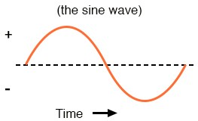
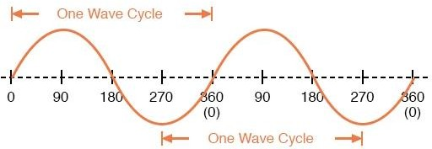
Direct Current Vs Alternating Current
DC voltage
AC voltage
+
-
Periodic Motion
1
Frequency(Hz) =
Period (s)

Slide 3
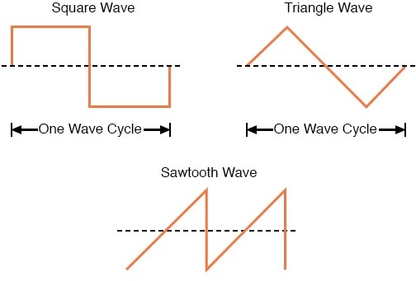
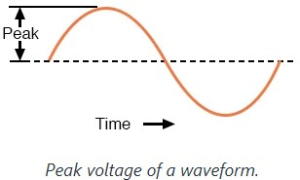
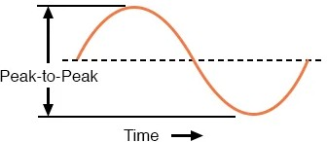
Types of AC waveforms
Types of waves

Slide 4
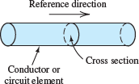

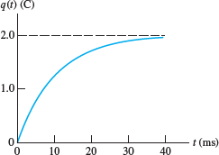

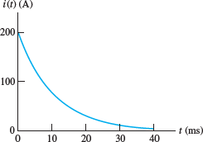
Current = f (time)
To find charge q(t)
_{I (t) =} dq(t)
dt
1A = ^{1C}
1s
For a given circuit element,
Sketch, q(t) and i(t)
= 0 − 2(−100)e^{−100t}

Slide 5
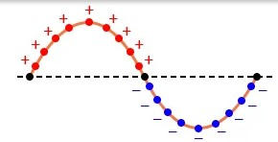
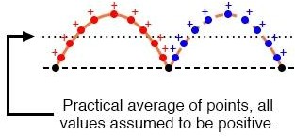
Sinusoidal wave – Average & RMS
AC
RMS –
Root Mean Square
DC
True Average
Practical Average – Measured by meter

Slide 6
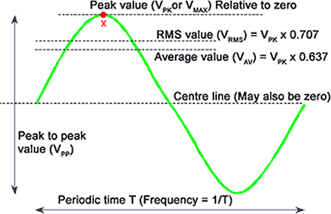
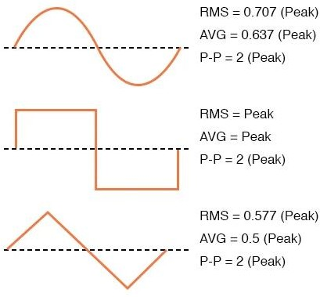
Values of different waveforms
V_{AV} = V_{PK} x 0.637
V_{RMS} = V_{PK} x 0.707 V_{PP} = V_{PK} x 2

Slide 7


Basic Quantities
At any time instant ‘t’ ???
∏
2∏
v(t) = V_{m} sin(ωt +θ )
……….. V_{pk} = V_{m}
V_{AV} = V_{PK} x 0.637
V_{RMS} = V_{PK} x 0.707
1
T
………………............
f =
V_{PP} = V_{PK} x 2
π ^{c} = 180º
sin(θ ) = cos(θ − 90º )

Slide 8








Root Mean Square (RMS) - I
Prashanth
2020-08-23 05:23:19
--------------------------------------------
E(t) = Pavg(t) * dt P --> kilo watt
E --> kilo watt hour
A periodic voltage v(t) is applied to a resistor R,
The power delivered to R is
Energy delivered in 1 period is
………………1W = ^{1J}
1s
Avg. power delivered to load in 1 period is
RMS value is defined as
π ^{c} = 180º
sin(θ ) = cos(θ − 90º )

Slide 9


Root Mean Square (RMS) Voltage related to P_{avg}
Average power
RMS voltage value is defined as
RMS value of VOLTAGE -
π ^{c} = 180º
sin(θ ) = cos(θ − 90º )

Slide 10


RMS Current related to P_{avg}
RMS voltage value is defined as
RMS current value is defined as
RMS value of CURRENT -
π ^{c} = 180º
sin(θ ) = cos(θ − 90º )

Slide 11
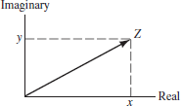
RMS values related Peak values
v(t) = V_{m} sin(ωt +θ )
₌ V_{m}
₌ I_{m}
V
I
rms
2
rms
2
SINUSOIDAL STEADY STATE ANALYSIS
3 sinusoidal voltage sources
Voltages and Currents
As vectors
PHASORS

Slide 12
Acknowledgements
https://www.allaboutcircuits.com
https://learnabout-electronics.org
Allan R. Hambley, ‘Electrical Engineering - Principles & Applications, Pearson Education, First Impression, 6/e, 2013

